Slide 1

Student Performance

Slide 2


Meet Salma and Shady. Both study in the same department, attend the same lectures, and take the same exams.
But their academic performance is vastly different.
Why?

Slide 3

Today, we will dive into real data from 5,000 students to uncover hidden patterns and key factors that influence academic success!

Slide 4



We will go through:
EDA & Findings & Insights
Data cleaning
Statistical Analysis

Slide 5

EDA
In the EDA phase of my project, I go thorough the dataset to understand its structure, detect anomalies, and identify patterns or trends. I began by checking for missing values and outliers, followed by visualizing key variables to gain initial insights. Correlations between different fields were explored. This process helped us uncover significant relationships between variables and provided a foundation for deeper analysis and decision-making.

Slide 6
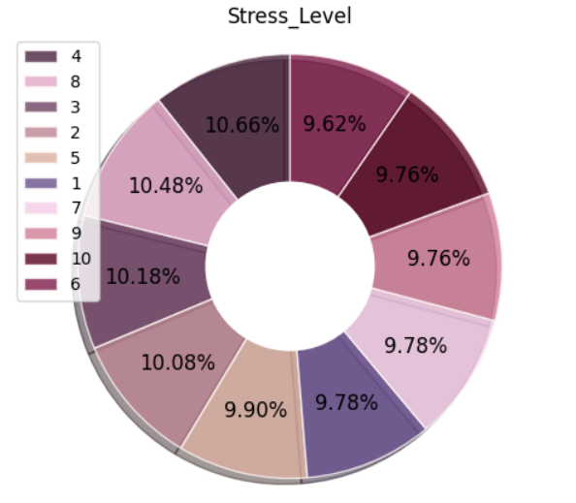
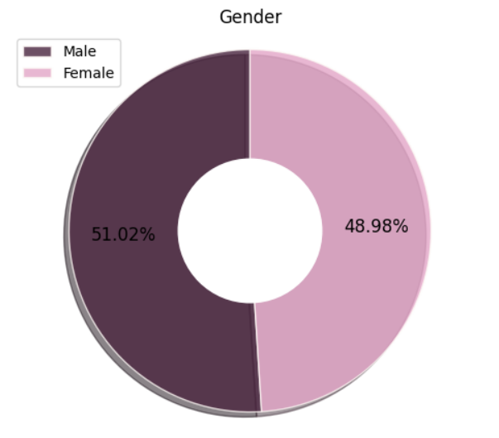
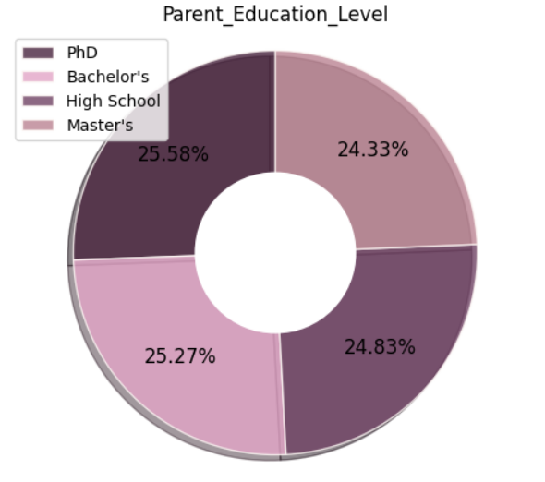
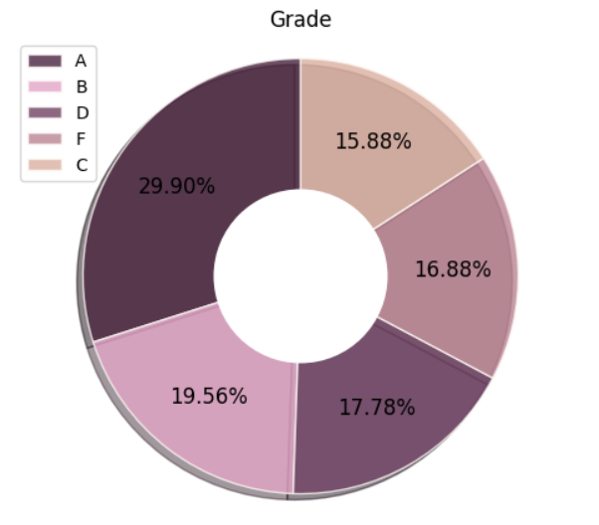
Stress Level & Gender & Parent Education Level & Grade are fairly evenly distributed, with no extreme peaks.

Slide 7
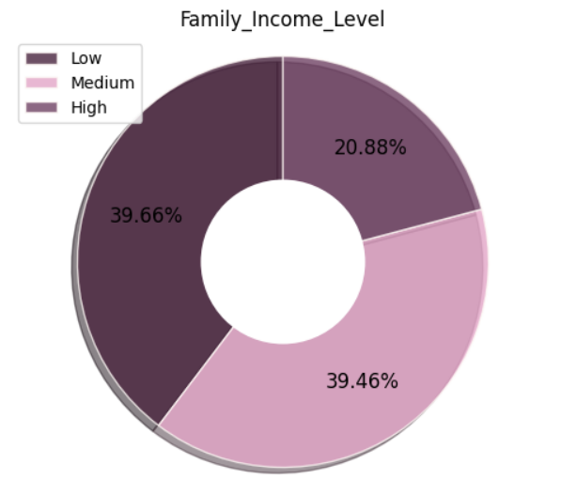
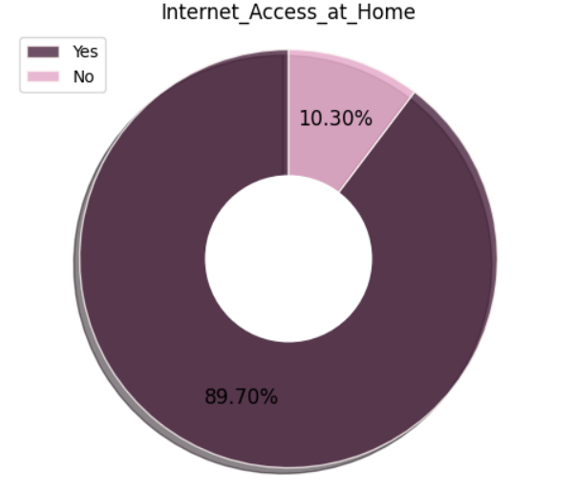
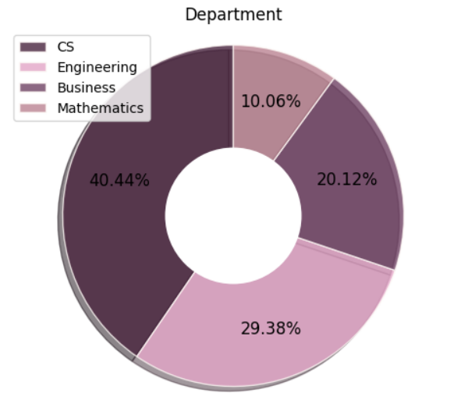
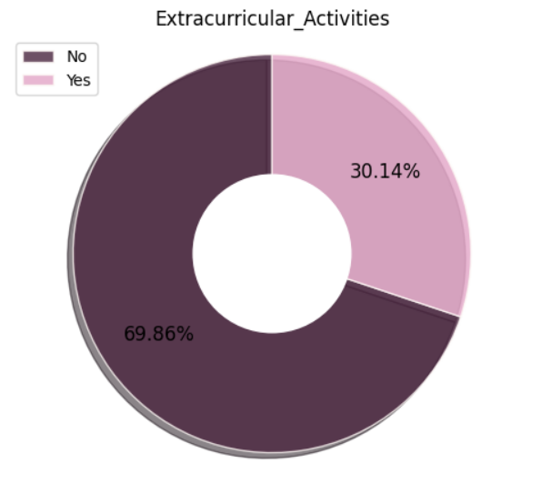
Internet Access at home & Family Income Levels & Extracurricular Activities & Department not fairly distributed, and have extreme peaks.

Slide 8
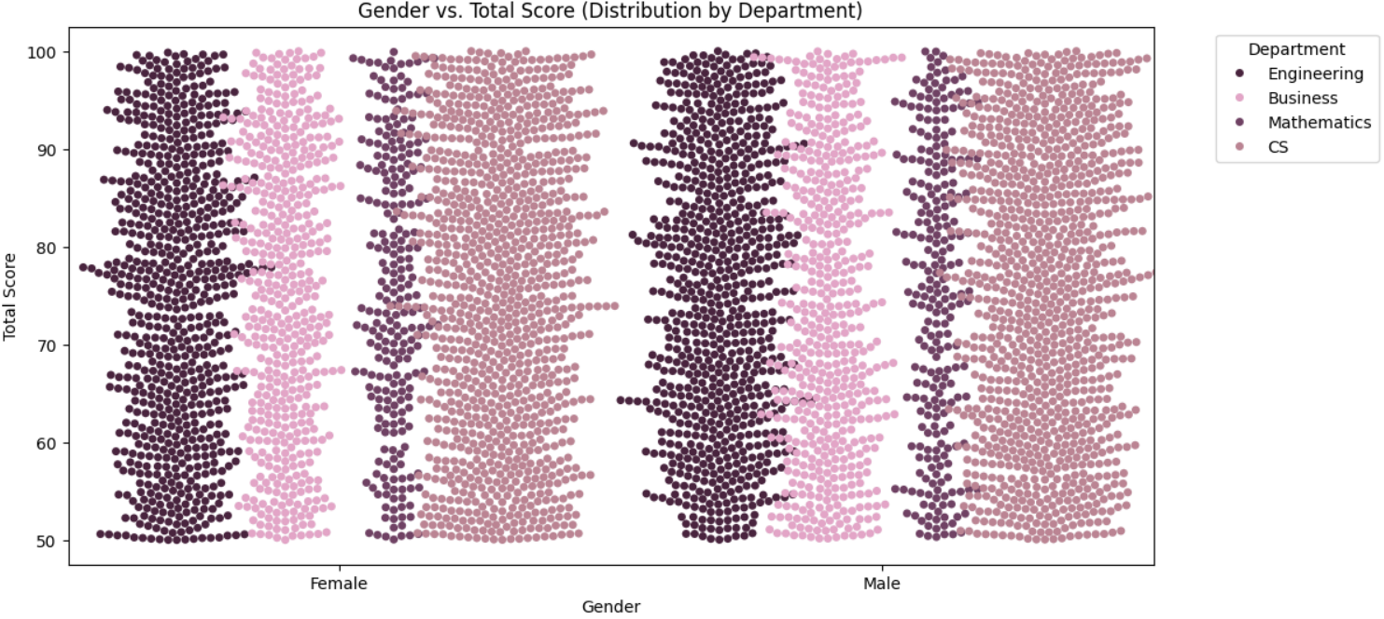
Gender vs. Performance
The distribution does not appear skewed towards very high or very low scores for any department or gender, indicating a fairly balanced performance trend.

Slide 9
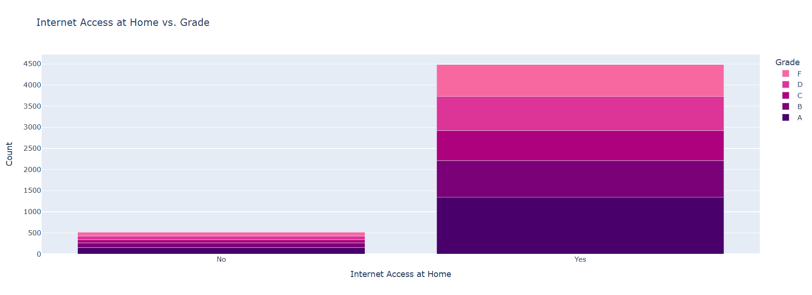
Are students with No Internet Access more likely to underperform?
The proportions of grades (A, B, C, D, F) appear consistent in both groups but I think students with Internet access at home perform better.

Slide 10
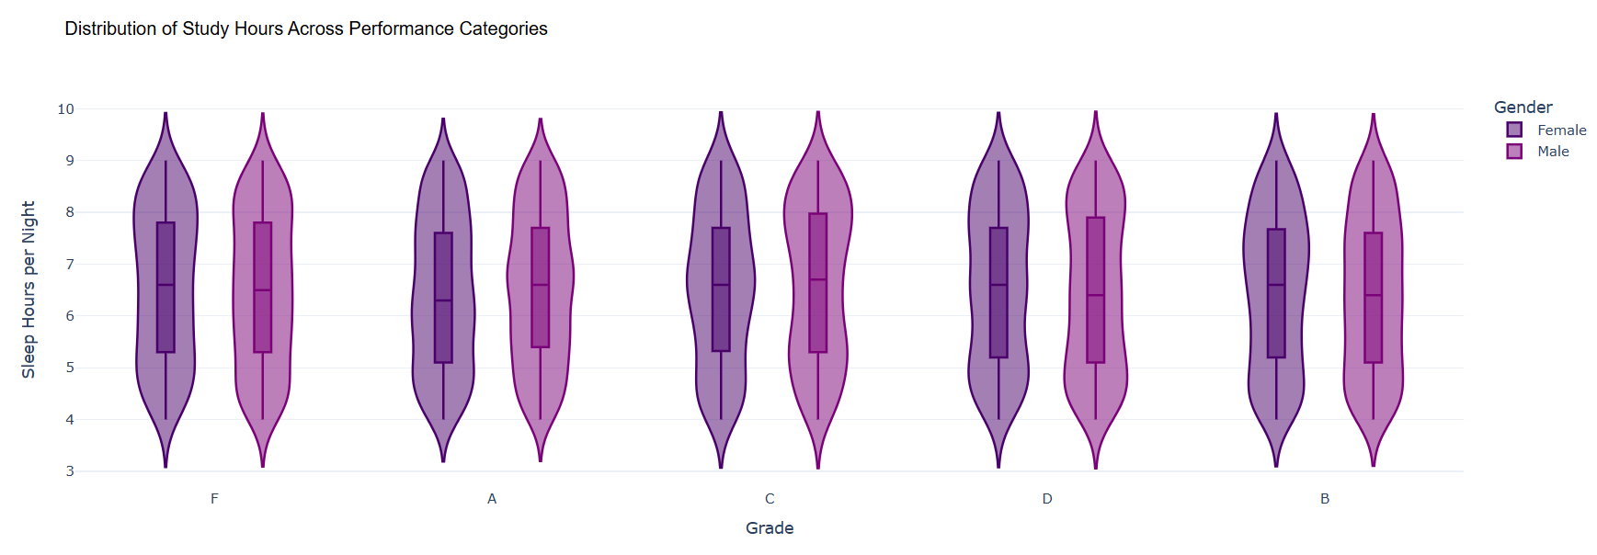
Do lower-performing students (F, D) sleep less than high-performing ones (A, B)?
The distribution of sleep hours is similar across all grades, Some students with low grades (F, D) still get enough sleep, suggesting other factors like study habits, stress, or engagement might play a role in their performance.

Slide 11
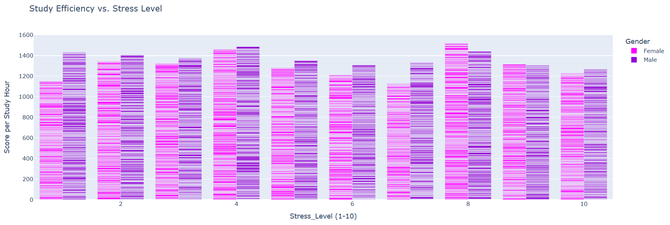
Impact of Stress on Study Hours & Performance according to Gender
Males appear to be more efficient under low to moderate stress levels, Females tend to maintain efficiency or adapt better at higher stress levels (8-10), so both genders experience a decline under extreme stress (10), but not drastically.

Slide 12
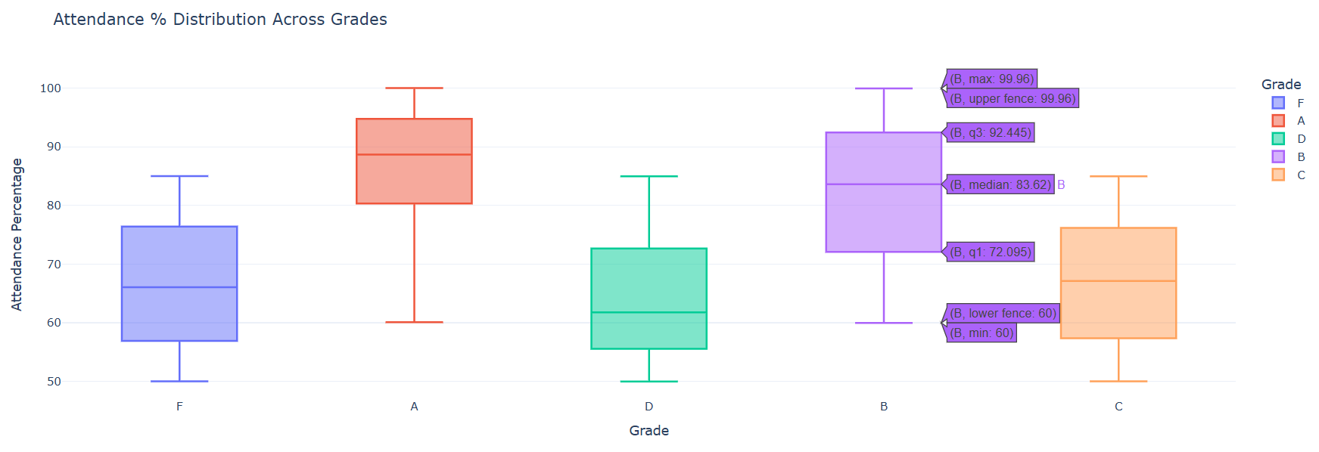
Do students with high Attendance (%) and Participation Score perform better?
Students with higher grades (A, B) tend to have higher attendance percentages.
Students with lower grades (D, F) show lower attendance rates

Slide 13
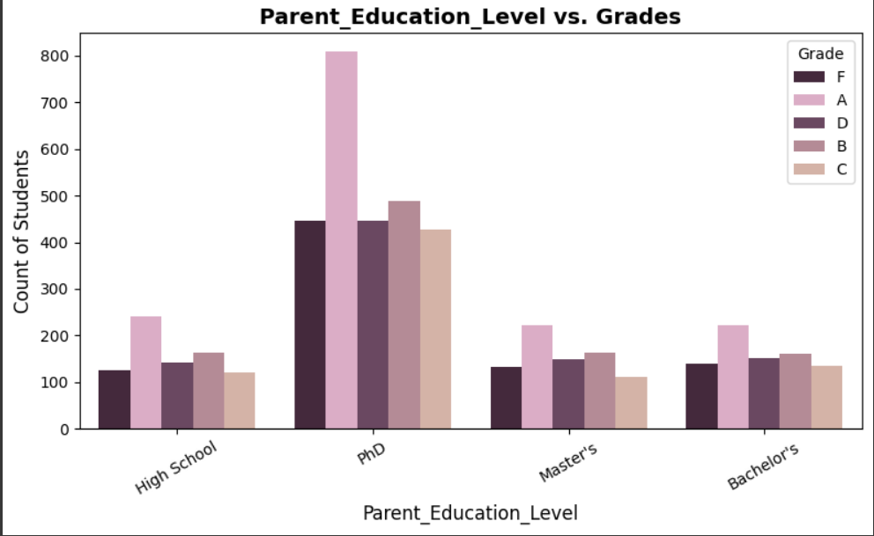
Does Parent Education influence student grades?
Higher education levels of parents may correlate with better student grades, while lower education levels may correlate with lower grades.

Slide 14
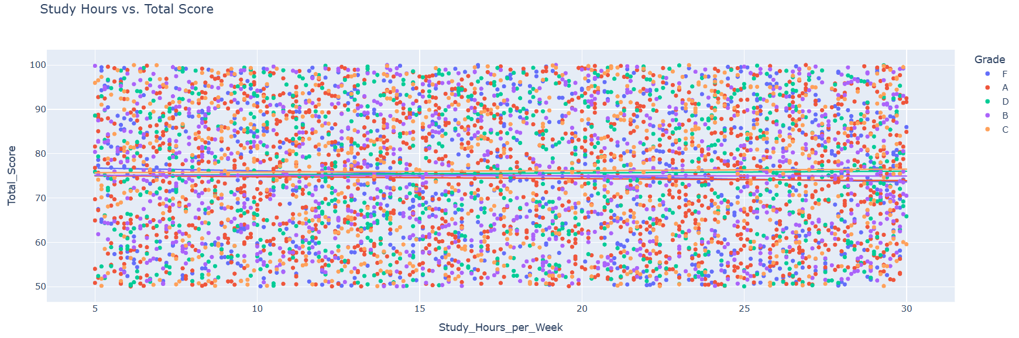
How do Study Hours per Week influence grades?
I think students may need better study techniques because study hours increase but performance remains unchanged

Slide 15
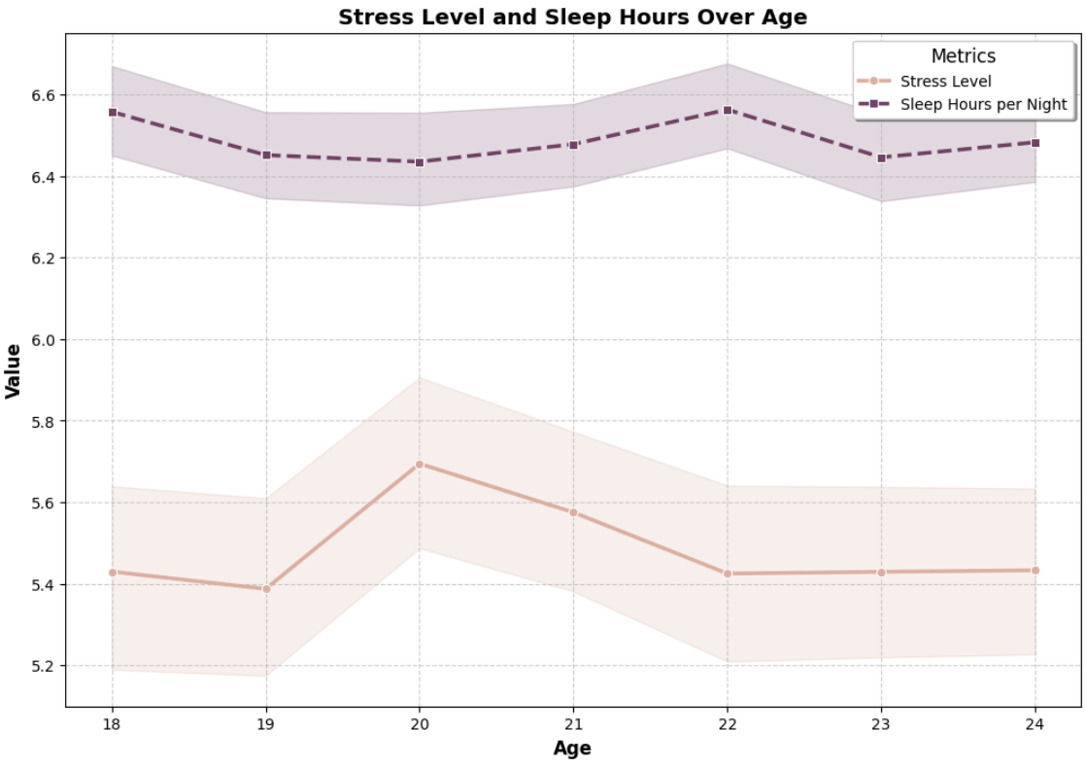
Stress Level and Sleep Hours Over Age
There is an inverse relationship between sleep hours and stress levels, Stress levels peak around age 20, while sleep hours are at their lowest between ages 19-21.

Slide 16
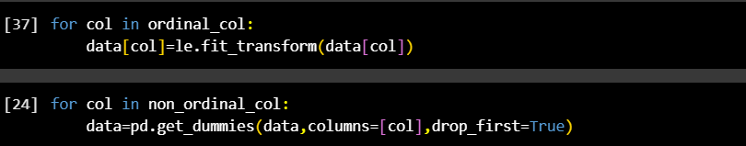
Data Cleaning
a crucial step in ensuring the dataset is accurate, complete, and ready for analysis. This process helps improve model performance by removing inconsistencies, errors, and irrelevant information.
1- Handling Missing Values
2- Encoding Categorical Variables
3- Removing Irrelevant Features

Slide 17
Feature Engineering
We define Efficiency as the ratio of a student’s total score to their study hours per week.
Comparing Efficiency across different grades and sleep patterns can reveal deeper trends in student performance.

Slide 18

Correlation Analysis
1- r: -0.03,P-value:0.0148, indicating a statistically significant relationship that hours of sleep are associated with attendance rates.
2- r: -0.57, P-value: 0.0000 Significant relationship found! More Grade correlate with more Attendance.
3- r: 0.04, P-value: 0.0108 Significant relationship found between Department Math with Efficiency.
4- r: 0.04, P-value: 0.0107 Significant relationship found! More Family Income Level correlate with more Efficiency.

Slide 19
Recommendations
Encouraging Participation: Promoting classroom engagement through interactive learning.
Encourage Regular Attendance: Monitor and improve attendance rates with engagement programs.
Address Stress and Sleep Deficiency: Offer stress management programs and mental health support services.
For students aged 19-21: Encourage better time management and stress management techniques.
Targeted Interventions: Support for students with lower socio-economic backgrounds to bridge performance gaps.
Enhance Digital Learning Accessibility: Ensure that all students have access to digital learning resources, especially at home.
Improve Study Techniques for Better Performance: Since increased study hours do not necessarily translate to higher scores, students may need more effective study techniques.

Slide 20

Thank you

